Slide 1
UNIX, Linux and Windows Operating Systems
Processes and Threads
Mirela Gutica
Technical Programming
BCIT

Slide 2
Example: Unix Process Execution Within User Processes
Notes:
Figure 3.16 suggests a typical process image structure for this strategy. A separate
kernel stack is used to manage calls/returns while the process is in kernel mode.
Operating system code and data are in the shared address space and are shared by
all user processes.
When an interrupt, trap, or supervisor call occurs, the processor is placed in
kernel mode and control is passed to the OS. To pass control from a user program
to the OS, the mode context is saved and a mode switch takes place to an operating
system routine. However, execution continues within the current user process. Thus,
a process switch is not performed, just a mode switch within the same process.
If the OS, upon completion of its work, determines that the current process
should continue to run, then a mode switch resumes the interrupted program within
the current process. This is one of the key advantages of this approach: A user
program has been interrupted to employ some operating system routine, and then
resumed, and all of this has occurred without incurring the penalty of two process
switches. If, however, it is determined that a process switch is to occur rather than
returning to the previously executing program, then control is passed to a process-
switching routine. This routine may or may not execute in the current process,
depending on system design. At some point, however, the current process has to be
placed in a nonrunning state and another process designated as the running process.
During this phase, it is logically most convenient to view execution as taking place
outside of all processes.
In a way, this view of the OS is remarkable. Simply put, at certain points in
time, a process will save its state information, choose another process to run from
among those that are ready, and relinquish control to that process. The reason this
is not an arbitrary and indeed chaotic situation is that during the critical time, the
code that is executed in the user process is shared operating system code and not
user code. Because of the concept of user mode and kernel mode, the user cannot
tamper with or interfere with the operating system routines, even though they are
executing in the user’s process environment. This further reminds us that there is
a distinction between the concepts of process and program and that the relationship
between the two is not one to one. Within a process, both a user program and
operating system programs may execute, and the operating system programs that
execute in the various user processes are identical.

Slide 3
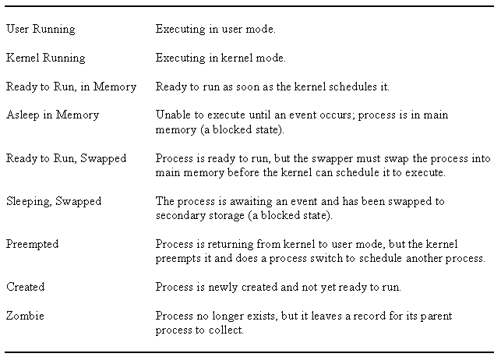
UNIX Process States

Slide 4
Notes:
UNIX Process State Transition Diagram
This figure is similar to Figure 3.9b , with the two
UNIX sleeping states corresponding to the two blocked states. The differences are
as follows:
• UNIX employs two Running states to indicate whether the process is executing
in user mode or kernel mode.
• A distinction is made between the two states: (Ready to Run, in Memory) and
(Preempted). These are essentially the same state, as indicated by the dotted
line joining them. The distinction is made to emphasize the way in which the
preempted state is entered. When a process is running in kernel mode (as a
result of a supervisor call, clock interrupt, or I/O interrupt), there will come
a time when the kernel has completed its work and is ready to return control
to the user program. At this point, the kernel may decide to preempt the current
process in favor of one that is ready and of higher priority. In that case,
the current process moves to the preempted state. However, for purposes of
dispatching, those processes in the Preempted state and those in the (Ready to
Run, in Memory) state form one queue.
Preemption can only occur when a process is about to move from kernel mode
to user mode. While a process is running in kernel mode, it may not be preempted.
This makes UNIX unsuitable for real-time processing. Chapter 10 discusses the
requirements for real-time processing.
Two processes are unique in UNIX. Process 0 is a special process that is created
when the system boots; in effect, it is predefined as a data structure loaded
at boot time. It is the swapper process. In addition, process 0 spawns process 1,
referred to as the init process; all other processes in the system have process 1 as
an ancestor. When a new interactive user logs on to the system, it is process 1 that
creates a user process for that user. Subsequently, the user process can create child
processes in a branching tree, so that any particular application can consist of a
number of related processes.

Slide 5
Process Creation
Process creation is by means of the kernel system call, fork( )
This causes the OS, in Kernel Mode, to:
1
Allocate a slot in the process table for the new process
2
Assign a unique process ID to the child process
3
Make a copy of the process image of the parent, with the exception of any shared memory
4
5
6
Increments counters for any files owned by the parent, to reflect that an additional process now also owns those files
Assigns the child process to the Ready to Run state
Returns the ID number of the child to the parent process, and a 0 value to the child process
Notes:
Process creation in UNIX is made by means of the kernel system call, fork( ). When
a process issues a fork request, the OS performs the following functions [BACH86]:
1. It allocates a slot in the process table for the new process.
2. It assigns a unique process ID to the child process.
3. It makes a copy of the process image of the parent, with the exception of any
shared memory.
4. It increments counters for any files owned by the parent, to reflect that an
additional process now also owns those files.
5. It assigns the child process to the Ready to Run state.
6. It returns the ID number of the child to the parent process, and a 0 value to
the child process.

Slide 6
After Creation
After creating the process the Kernel can do one of the following, as part of the dispatcher routine:
stay in the parent process
transfer control to the child process
transfer control to another process
Notes:
When the kernel has completed these functions it can do one of the following, as part of
the dispatcher routine:
• Stay in the parent process. Control returns to user mode at the point of the fork call of the parent.
• Transfer control to the child process. The child process begins executing at the same point in the code as the parent, namely at the return from the fork call.
• Transfer control to another process. Both parent and child are left in the Ready to Run state.

Slide 7
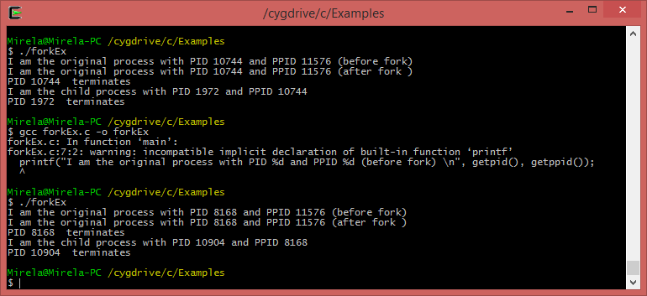
Result of Running the Fork() Example
Result after Running the Fork() Example

Slide 8
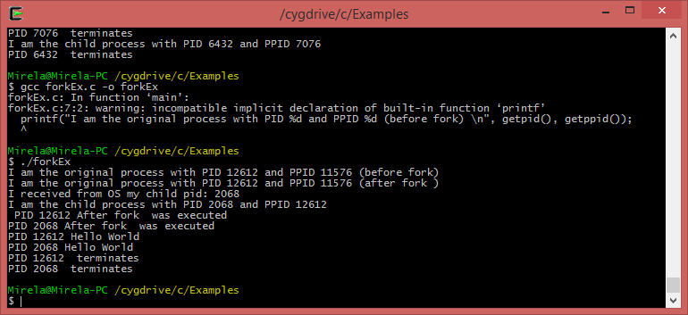
Result of Running the Fork() Example (More Instructions after fork()); Note the Order of Execution (1)

Slide 9
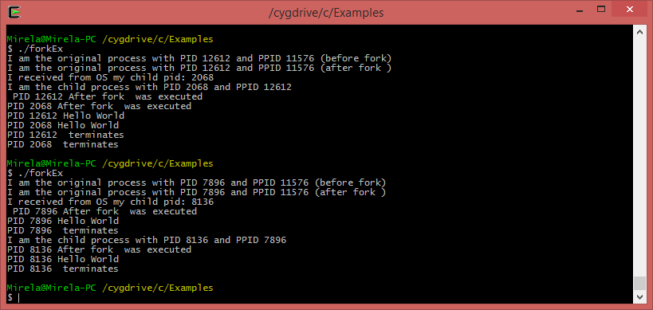
Result of Running the Fork() Example (More Instructions after fork()); Note the Order of Execution (2)

Slide 10
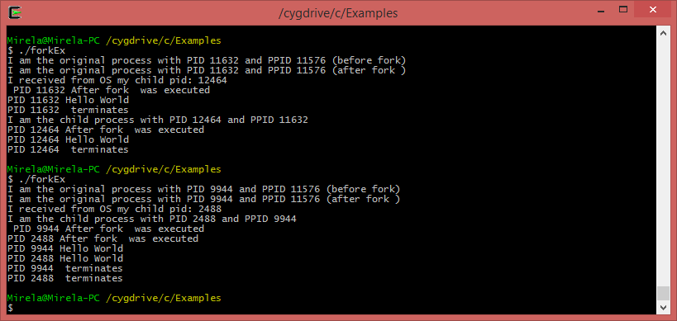
Result of Running the Fork() Example (More Instructions after fork()); Note the Order of Execution (3). Why Is Different?

Slide 11
Unix
History and flavors of Unix
Please read:
http://www.unix.org/what_is_unix/history_timeline.html
http://www.linfo.org/flavors.html

Slide 12
Solaris Process
makes use of four thread-related concepts:
Process
includes the user’s address space, stack, and process control block
User-level Threads
a user-created unit of execution within a process
Lightweight Processes (LWP)
a mapping between ULTs and kernel threads
Kernel Threads
fundamental entities that can be scheduled and dispatched to run on one of the system processors
Notes:
Solaris makes use of four separate thread-related concepts:
• Process: This is the normal UNIX process and includes the user’s address
space, stack, and process control block.
• User-level threads: Implemented through a threads library in the address
space of a process, these are invisible to the OS. A user-level thread (ULT) is a user-created unit of execution within a process.
• Lightweight processes: A lightweight process (LWP) can be viewed as a mapping
between ULTs and kernel threads. Each LWP supports ULT and maps to one kernel thread. LWPs are scheduled by the kernel independently and may execute in parallel on multiprocessors.
• Kernel threads: These are the fundamental entities that can be scheduled and
dispatched to run on one of the system processors.

Slide 13
Solaris Processes and Threads
Process includes the user’s address space, stack, and process control block
User-level threads (ULT)
At the user library level
Lightweight processes (LWP)
Mapping between ULT and kernel threads.
Kernel threads

Slide 14
Notes:
Figure 4.12 illustrates the relationship among these four entities. Note that there is always exactly one kernel thread for each LWP. An LWP is visible within a process to the application. Thus, LWP data structures exist within their respective process address space. At the same time, each LWP is bound to a single dispatchable kernel thread, and the data structure for that kernel thread is maintained within the kernel’s address space.
A process may consist of a single ULT bound to a single LWP. In this case, there is a single thread of execution, corresponding to a traditional UNIX process. When concurrency is not required within a single process, an application uses this process structure. If an application requires concurrency, its process contains multiple threads, each bound to a single LWP, which in turn are each bound to a single kernel thread.
In addition, there are kernel threads that are not associated with LWPs. The kernel creates, runs, and destroys these kernel threads to execute specific system functions. The use of kernel threads rather than kernel processes to implement system functions reduces the overhead of switching within the kernel (from a process switch to a thread switch).

Slide 15
Notes:
Figure 4.13 compares, in general terms, the process structure of a traditional UNIX system with that of Solaris. On a typical UNIX implementation, the process structure includes the process ID; the user IDs; a signal dispatch table, which the kernel uses to decide what to do when sending a signal to a process; file descriptors, which describe the state of files in use by this process; a memory map, which defines the address space for this process; and a processor state structure, which includes the kernel stack for this process. Solaris retains this basic structure but replaces the processor state block with a list of structures containing one data block for each LWP.

Slide 16
Linux Tasks
A process, or task, in Linux is represented by a task_struct data structure
This structure contains information in a number of categories
Notes:
A process, or task, in Linux is represented by a task_struct data structure. The task_struct data structure contains information in a number of categories:
• State:
The execution state of the process (executing, ready, suspended, stopped, zombie). This is described subsequently.
• Scheduling information:
Information needed by Linux to schedule processes. A process can be normal or real time and has a priority. Real-time processes are scheduled before normal processes, and within each category, relative priorities can be used. A counter keeps track of the amount of time a process is allowed to execute.
• Identifiers:
Each process has a unique process identifier and also has user and group identifiers. A group identifier is used to assign resource access privileges to a group of processes.
• Interprocess communication:
Linux supports the IPC mechanisms found in UNIX SVR4, described in Chapter 6 .
• Links:
Each process includes a link to its parent process, links to its siblings (processes with the same parent), and links to all of its children.
Times and timers:
Includes process creation time and the amount of processor time so far consumed by the process. A process may also have associated one or more interval timers. A process defines an interval timer by means of a system call; as a result, a signal is sent to the process when the timer expires. A timer may be single use or periodic.
• File system:
Includes pointers to any files opened by this process, as well as pointers to the current and the root directories for this process.
• Address space:
Defines the virtual address space assigned to this process.
• Processor-specific context:
The registers and stack information that constitute the context of this process.

Slide 17
Linux Processes and Threads
User level threads have been introduced in version 1.0.9 and kernel level threads in version 1.3.56.
New versions of Linux support “N to M” threading scheme
kse - kernel support for user threads
Many Linux kernel subsystems do not distinguish between processes and threads – they are both called tasks.
Linux uses fork() to spawn child tasks.
Linux supports POSIX threads
http://man7.org/linux/man-pages/man7/pthreads.7.html

Slide 18
Posix Threads
Posix is a standard (pthread).
What is a POSIX lib?
It is a POSIX threads library for a system that supports POSIX threads
How are pthreads implemented on a particular system?
This is up to the kernel developer

Slide 19
pthread_create()
int pthread_create(pthread_t *tid, const pthread_attr_t *, void *(*func)(void *), void *arg);
start function func with argument arg in new thread
return 0 if ok, >0 if not

Slide 20
fork(), vfork(), exec() - Unix and Linux
The fork() system call makes a duplicate of the current process
vfork(): the parent process is temporarily suspended, and the child process can borrow the parent's address space
exec(): replaces the new created process with a real one (not a duplicate anymore) by indicated a pointer to the function or existing application (e.g., Notepad) that should execute

Slide 21
clone() - Linux
clone() creates a new “process” that shares parts of the parent’s context
The flag CLONE_THREAD will place the new thread in the same thread group as the calling process
Unlike fork, this call allows the child process to share parts of its execution context with the calling process, such as the memory space, the table of file descriptors, and the table of signal handlers
http://www.tutorialspoint.com/unix_system_calls/clone.htm
Notes:
More details are in the textbook

Slide 22
Windows 7/8 (starting with Windows 2000)
Windows processes are created from the user level, but the creation is executed inside the kernel
Threads are the actual unit of execution
Each process has at least one thread of execution
When the system initialize a process, it creates a primary thread
The primary thread is like any other thread, except that when it returns, the process terminates
Scheduling in Windows is done at the level of threads

Slide 23
Multithreaded Process - Windows
Achieves concurrency without the overhead of using multiple processes
Threads within the same process can exchange information through their common address space and have access to the shared resources of the process
Threads in different processes can exchange information through shared memory that has been set up between the two processes – use Inter-Process Communication
Notes:
Windows supports concurrency among processes because threads in different processes may execute concurrently (appear to run at the same time). Moreover, multiple threads within the same process may be allocated to separate processors and execute simultaneously (actually run at the same time). A multithreaded process achieves concurrency without the overhead of using multiple processes. Threads within the same process can exchange information through their common address space and have access to the shared resources of the process. Threads in different processes can exchange information through shared memory that has been set up between the two processes.
An object-oriented multithreaded process is an efficient means of implementing a server application. For example, one server process can service a number of clients concurrently.

Slide 24
Notes:
An existing Windows thread is in one of six states ( Figure 4.11 ):
• Ready: A ready thread may be scheduled for execution. The Kernel dispatcher
keeps track of all ready threads and schedules them in priority order.
• Standby: A standby thread has been selected to run next on a particular processor.
The thread waits in this state until that processor is made available. If the standby thread’s priority is high enough, the running thread on that processor may be preempted in favor of the standby thread. Otherwise, the standby thread waits until the running thread blocks or exhausts its time slice.
• Running: Once the Kernel dispatcher performs a thread switch, the standby
thread enters the Running state and begins execution and continues execution until it is preempted by a higher-priority thread, exhausts its time slice, blocks, or terminates. In the first two cases, it goes back to the Ready state.
• Waiting: A thread enters the Waiting state when (1) it is blocked on an event
(e.g., I/O), (2) it voluntarily waits for synchronization purposes, or (3) an environment subsystem directs the thread to suspend itself. When the waiting
condition is satisfied, the thread moves to the Ready state if all of its resources are available.
• Transition: A thread enters this state after waiting if it is ready to run but the
resources are not available. For example, the thread’s stack may be paged out of memory. When the resources are available, the thread goes to the Ready state.
• Terminated: A thread can be terminated by itself, by another thread, or when
its parent process terminates. Once housekeeping chores are completed, the thread is removed from the system, or it may be retained by the Executive for future re-initialization.

Slide 25
Thread Pool - Windows
Windows provides each process with a thread pool that consists of a number of worker threads which are kernel level threads
The thread pool consists of worker threads that sleep until a request is queued to the pool
Because the functions specified by user threads may outnumber worker threads, Windows maintains requests to execute the functions in a queue
Instead creating and destroying threads, the process queues the request to its pool of worker threads

Slide 26
Fibers - Windows
Threads can create fibers, which are similar with thread, except that the fiber is scheduled by the thread
Fibers are implemented to provide compatibility with other operating systems for mapping user-level threads to kernel level threads

Slide 27
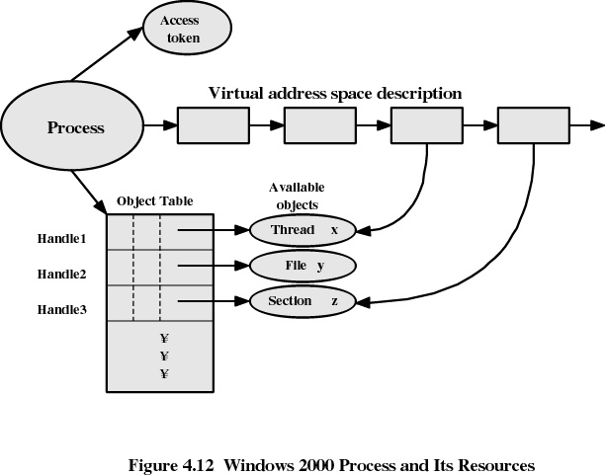

Slide 28
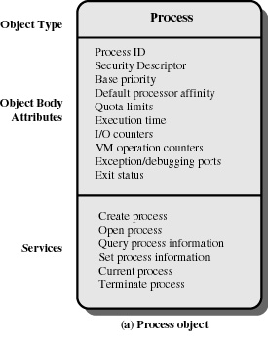
Windows Process Object

Slide 29
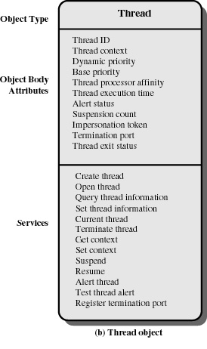
Windows Thread Object

